Slide 1

Smithgall Woods Website
Project Updates
MIST7590 – MIT Project I
Andrea Castresana
Jennifer Lazo
Alexander Couch
Clark Williams
Eliseo Santos
September 20, 2017

Slide 2
Overview
Team Member Roles
Investigation of the Website
Proposed Solutions to Security Vulnerability
Suggested User Requirements
Home Page Mockups
Successes
Challenges
Way Ahead

Slide 3
Team Member Roles
Team Leader/Project Manager – Eliseo
Client-side Developer – Jennifer, Andrea
Server-side Developer – Jennifer, Alex, Eliseo
Database Manager – Eliseo, Clark
UI/UX Design Manager – Alex, Jennifer
Test Manager – Eliseo, Clark
Business Analyst/Requirements Manager – Andrea, Clark

Slide 4
Investigation of the Website
Existence of unnecessary accounts
Some accounts may be removed if the Friends of Smithgall Woods agree that they are unnecessary
Outdated Plugins
Malicious injected code with hidden links
Common problem in WordPress versions 2.8x and attackers are able to get into the \wp-admin\upload.php file and insert files on the server
A base64_decode on the second line of the \wp-includes\locale.php file was found and identified as part of the injected malicious code that triggers the “cialis” messages with external web links to be displayed in multiple site pages

Slide 5
Proposed Solutions to Security Vulnerability
Delete the malicious injected code from the file
Commenting the injected code out prevents the “Cialis” messages with hyperlinks from being displayed throughout the site
Update plugins & software to suggested versions
Remove unnecessary accounts
Change the passwords for all remaining accounts
Recommend using Java & JavaScript for rebuilding the site
Use hosting website’s security app to prevent further issues
1&1 SiteLock (Basic or Premium Subscription)

Slide 6
Suggested User Requirements
A. Website Pages (Site navigation & content presentation)
Requirement #1: Smithgall Woods website shall be designed with user-friendly navigation that allows users to find information quickly through logical menu structure.
Requirement #2: Smithgall Woods website content of each page shall be arranged in a way to improve its appearance and make it interesting to existing users and future visitors to the site.
B. Become a Friend or Volunteer Page
Requirement #1: The page shall have more detailed information about becoming a friend or volunteer including directions, volunteer training day information, and working hyperlinks.
Requirement #2: All hyperlinks shall be active, correct, and current.

Slide 7
Suggested User Requirements (Cont.)
C. Cottage Accommodations Page
Requirement #1: Smithgall Woods cottage accommodations page shall link directly to the relevant state parks reservations page.
Requirement #2: Smithgall Woods cottage accommodations page shall be renamed to Reservations and list group (pioneer) camping and picnic shelter information, which are reserved through the same link.
D. Volunteer Hours Log Page with Mobile Capability
Requirement #1: Smithgall Woods application shall validate volunteers, jobs and hours by authentication process.
Requirement #2: Smithgall Woods application shall be formatted with mobile devices in mind so that logging data via mobile is user-friendly.

Slide 8
Suggested User Requirements (Cont.)
E. Volunteer Report Generator Page with Separate Login
Requirement #1: Smithgall Woods application shall generate volunteer reports showing the number of volunteer hours.
Requirement #2: Smithgall Woods application shall be capable of setting up user access to Report Generator for designated individuals only.

Slide 9
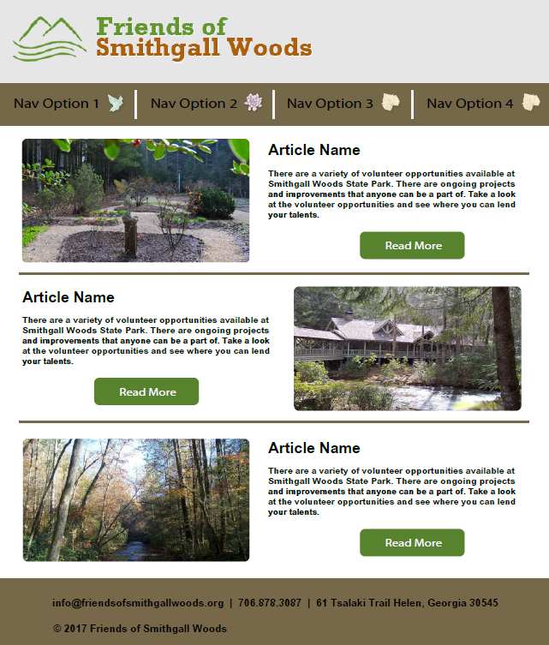
Home Page Mockups (Desktop Version)

Slide 10
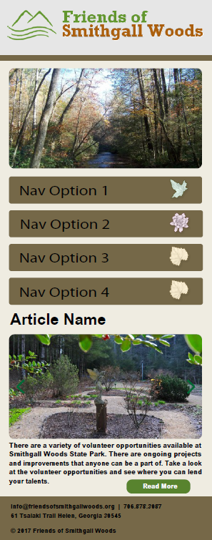
Home Page Mockups (Mobile Version)

Slide 11
Successes
Found malicious injected code
Prevented the injected code from being displayed temporarily
Developed recommended solutions

Slide 12
Challenges
Limited knowledge of using WordPress and PHP
One team member has some experience using these tools
Difficulty in finding any remaining malicious injected codes

Slide 13
Way Ahead
Prioritize user requirements from high to low & define system requirements by Sep 24th
Update WBS/Project Plan by Sep 30th
Plan for Incremental Approach
Build simple prototype of the website
Meet with stakeholders

Slide 14
BACKUPS

Slide 15
Dr. Huber’s Recommendation
This project will be more of a rebuild and enhance than a reinvent the wheel
However, the analysis and your team’s recommendations will also be a major deliverable for Fall
Look at the existing website and extract what you think are the initial requirements of the Friends Chapter
This will also give you an idea of the feature set and UI/UX
Biggest complaints about the website were ease of update/maintenance, and security
Use the feature set you discover to create a starting point for the conversation with the sponsor.

Slide 16
Existing Login Accounts
Hosting site
17505820 – Dr. Huber’s account
Databases
db357026991 (FSGW)
db358933030 (FSGWData); Database for Volunteer Hours
db360322876 (Fresh root WP install): This is the database the WordPress site pulls from and saves to for page content.
db265662256 (login and hours database): We think this is the volunteer hours db.
db268336715 (calendardb)
FTP accounts
u48922589
u48922589-drdan : This is the only account we can access. The passwords for the others are incorrect. We only need one account, so we propose getting rid of the remaining
u48922589-students
u48922589-Admin
WordPress accounts
mhuber (mhuber@uga.edu)
admin (youdomaincom977@gmail.com) : this is the default admin name in WP and we suggest that it should be changed via the wp_users table in the database, assuming that nothing becomes disrupted
Admin1 (webmaster@friendsofsmithgallwoods.org)
lcompton (compton.pl@gmail.com) : Web Committee Leader

Slide 17
Development Approach
Use Incremental Approach
Learn using WordPress & PHP
Use single type IDE/Code Editor (Eclipse)
Use Java and JavaScript Libraries
Simplify rebuild of the website
Avoid reinventing the wheel
Build a simple prototype of the website

Slide 18
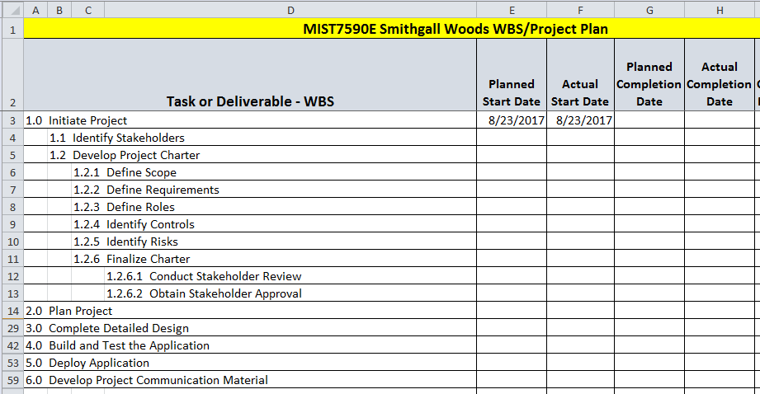
WBS/Project Plan
Update Project Plan by Sep 30th

Slide 19
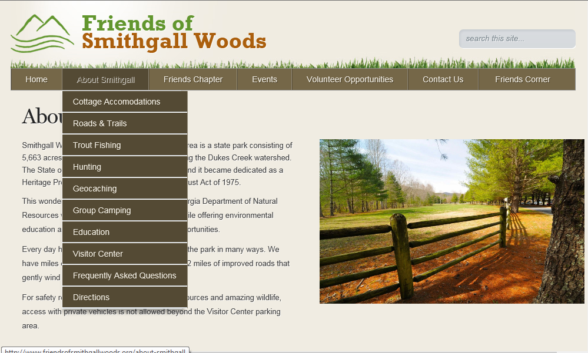
Site Pages

Slide 20
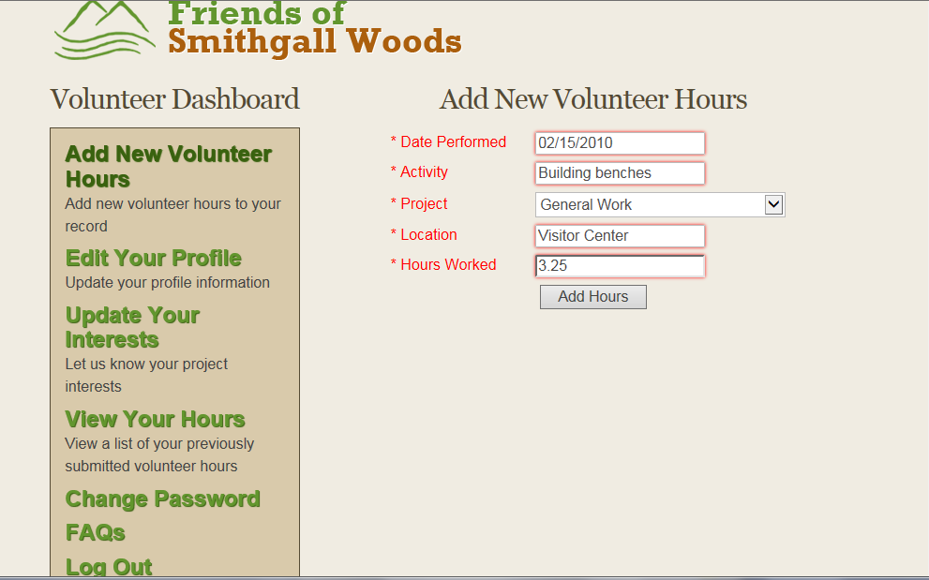
Volunteer Hours Log Page

